Slide 1
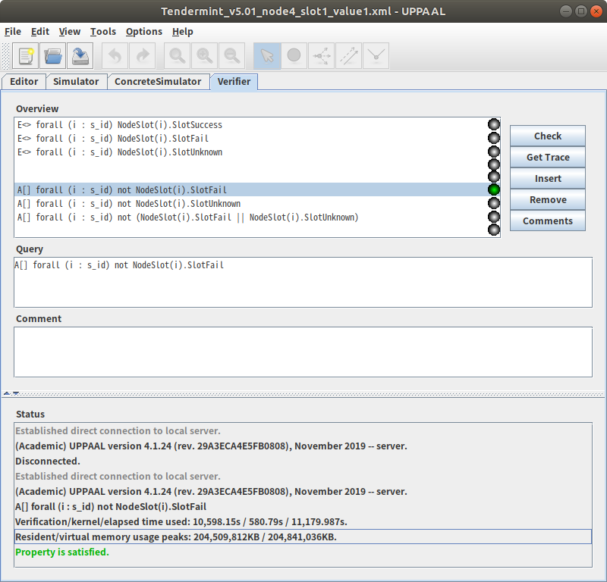
Tendermint_v5.01_node4_slot1_value1
(Breadth first/Aggressive/CompactDataStructure option)
Verification for Prop4.
A[] forall (i : s_id) not NodeSlot(i).SlotFail
Verification/kernel/elapsed time used: 10,598.15s / 580.79s / 11,179.987s.
Resident/virtual memory usage peaks: 204,509,812KB / 204,841,036KB.
1
Notes:
1

Slide 2
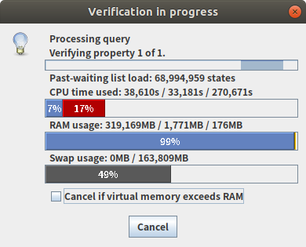
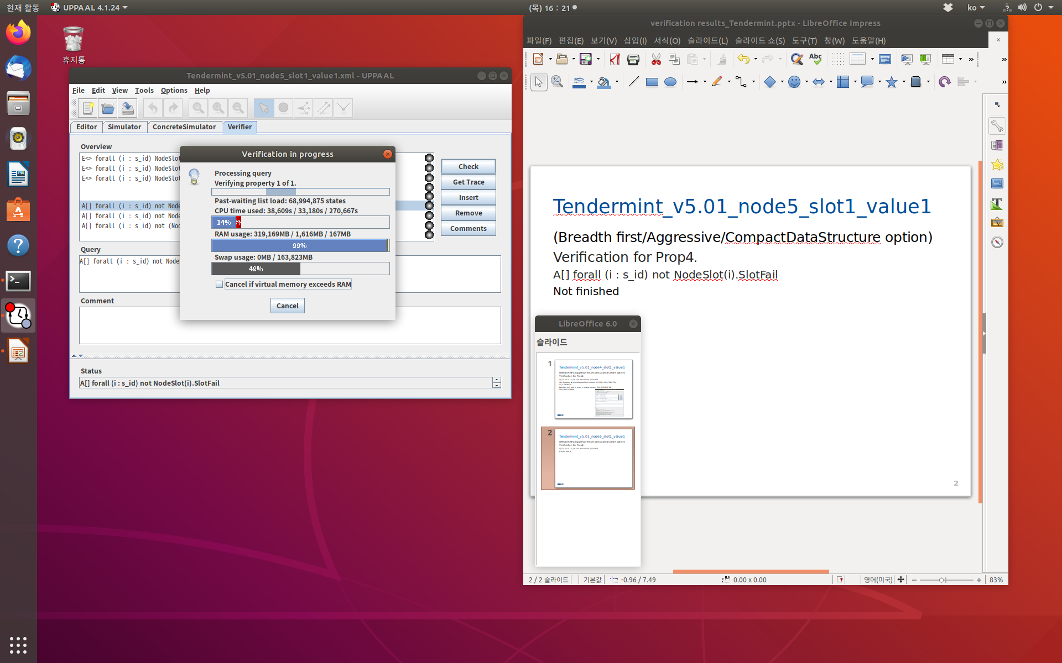
Tendermint_v5.01_node5_slot1_value1
(Breadth first/Aggressive/CompactDataStructure option)
Verification for Prop4.
A[] forall (i : s_id) not NodeSlot(i).SlotFail
Not finished
1
Notes:
<숫자>

Slide 3
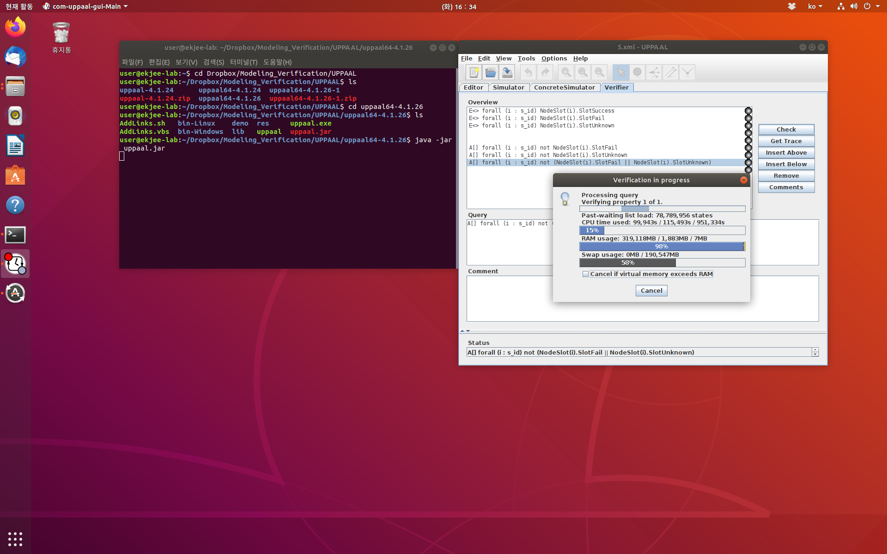
5.xml
(Breadth first/Aggressive/CompactDataStructure option)
Verification for Prop6.
A[] forall (i : s_id) not (NodeSlot(i).SlotFail ||NodeSlot(i).SlotUnknown)Not finished
Not finished
1
Notes:
<숫자>

Slide 4
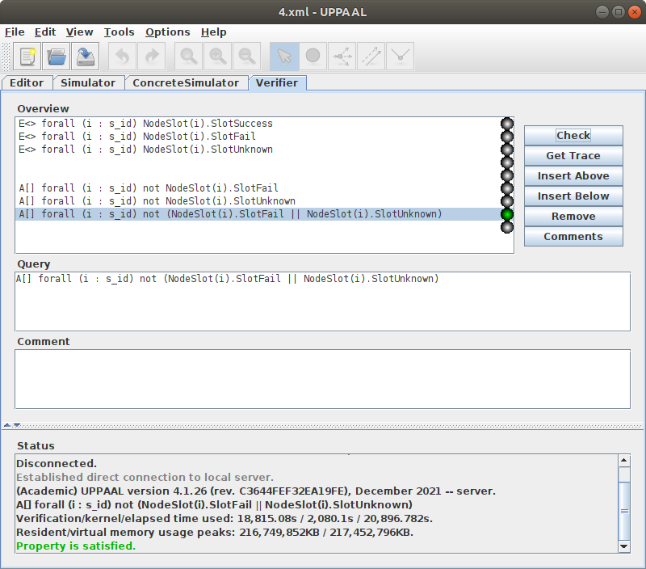
4.xml
(Breadth first/Aggressive/CompactDataStructure option)
Verification for Prop6.
A[] forall (i : s_id) not (NodeSlot(i).SlotFail ||NodeSlot(i).SlotUnknown)Not finished
Verification/kernel/elapsed time used: 18,815.08s / 2,080.1s / 20,896.782s
Resident/virtual memory usage peaks:
216,749,852KB / 217,452,796KB
1
Notes:
<숫자>

Slide 5
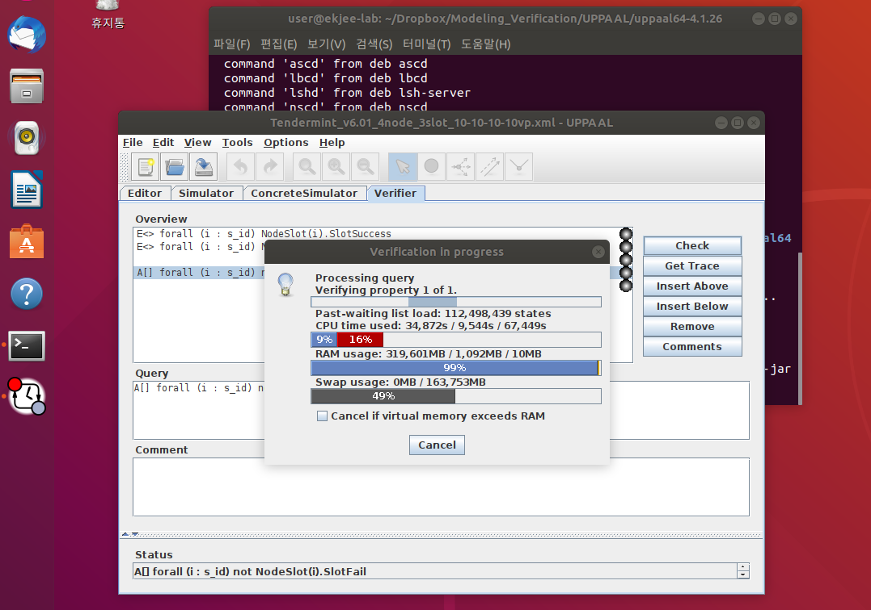
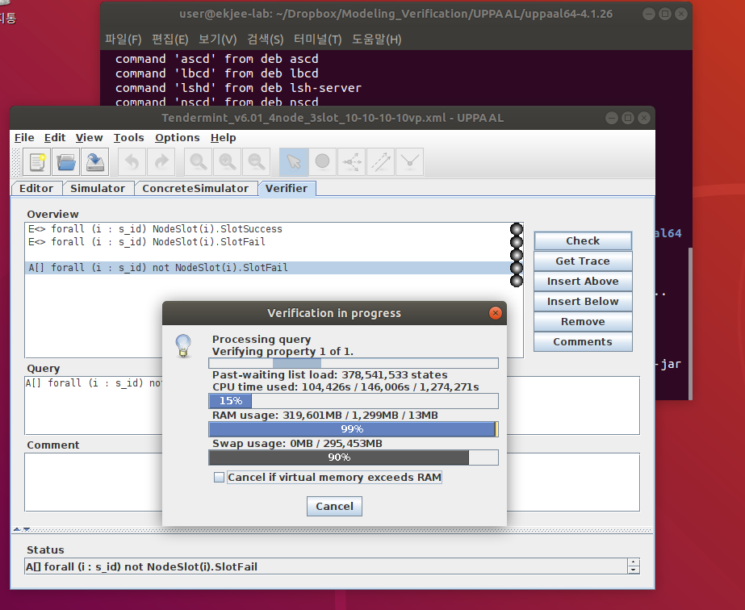
Tendermint_v6.01_4node_3slot_10-10-10vp.xml.xml
(Breadth first/Aggressive/CompactDataStructure option)
Verification for Prop6.
A[] forall (i : s_id) not NodeSlot(i).SlotFail
Verification/kernel/elapsed time used:
Resident/virtual memory usage peaks:
1
Notes:
<숫자>

Slide 6
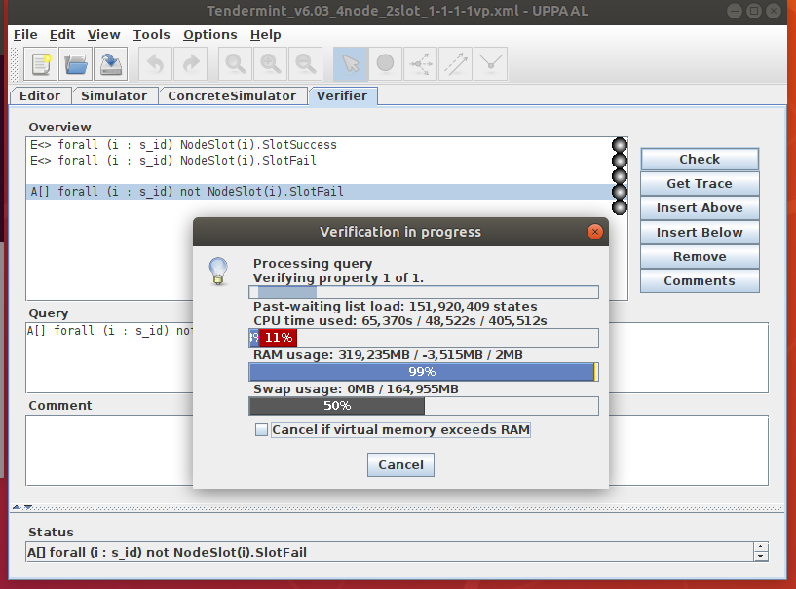
Tendermint_v6.03_4node_2slot_1-1-1-1vp.xml
(Breadth first/Aggressive/CompactDataStructure option)
Verification for Prop6.
A[] forall (i : s_id) not NodeSlot(i).SlotFail
Verification/kernel/elapsed time used:
Resident/virtual memory usage peaks:
1
Notes:
<숫자>

Slide 7
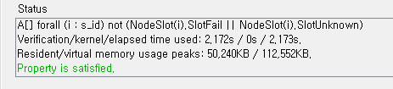
Tendermint_v7.01_5node_3slot_1-1-1-1vp.xml
(Breadth first/Aggressive/CompactDataStructure option)
Open membership:5-3-4
A[] forall (i : s_id) not (NodeSlot(i).SlotFail || NodeSlot(i).SlotUnknown)
Verification/kernel/elapsed time used: 2.172s / 0s / 2.173s.
Resident/virtual memory usage peaks: 50,240KB / 112,552KB.

Slide 8
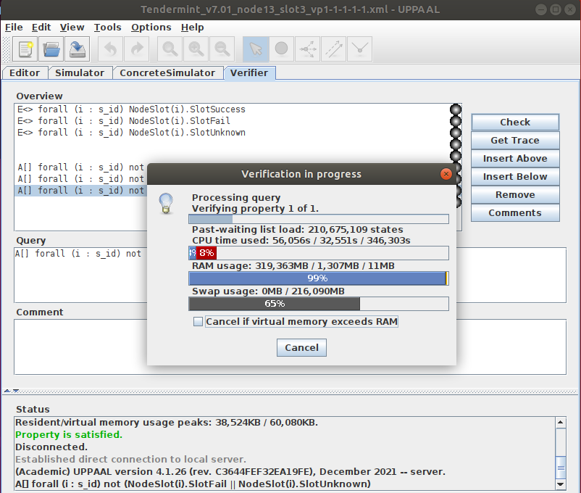
Tendermint_v7.01_node13_slot3_vp1-1-1-1.xml
(Breadth first/Aggressive/CompactDataStructure option)

Slide 9
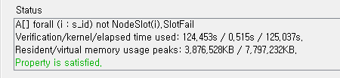
Tendermint_v7.03_node5_slot3_vp1.xml
(Breadth first/Aggressive/CompactDataStructure option)

Slide 10
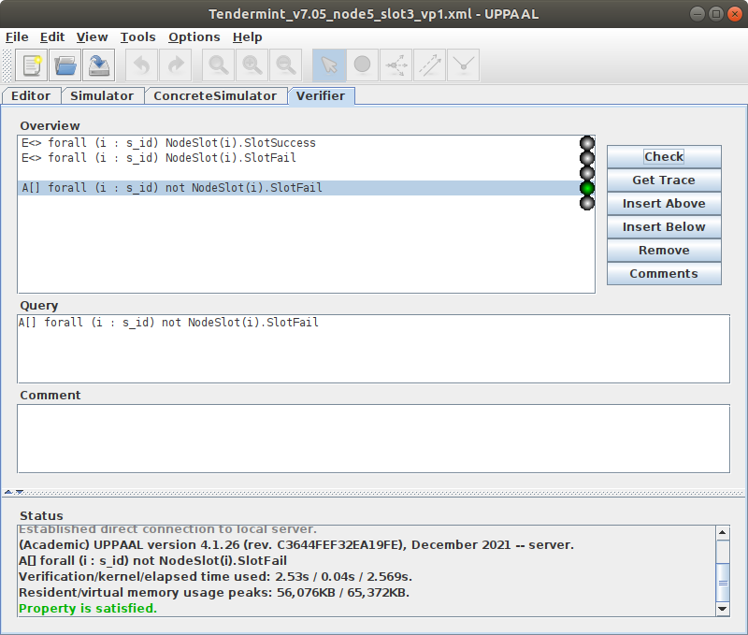
Tendermint_v7.05_node5_slot3_vp1.xml
(Breadth first/Aggressive/CompactDataStructure option)

Slide 11
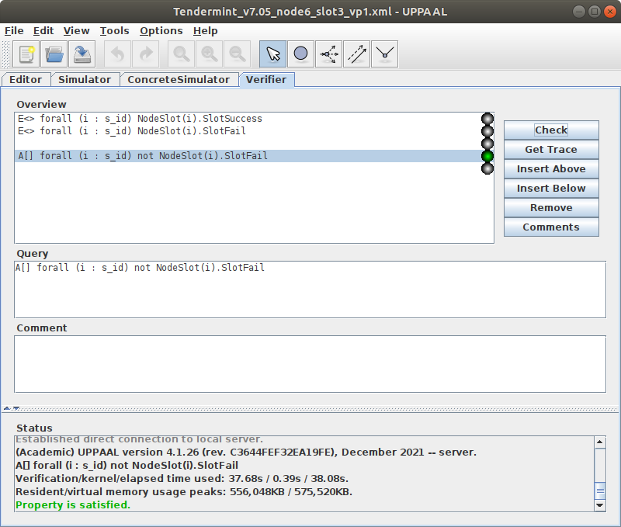
Tendermint_v7.05_node6_slot3_vp1.xml
(Breadth first/Aggressive/CompactDataStructure option)

Slide 12
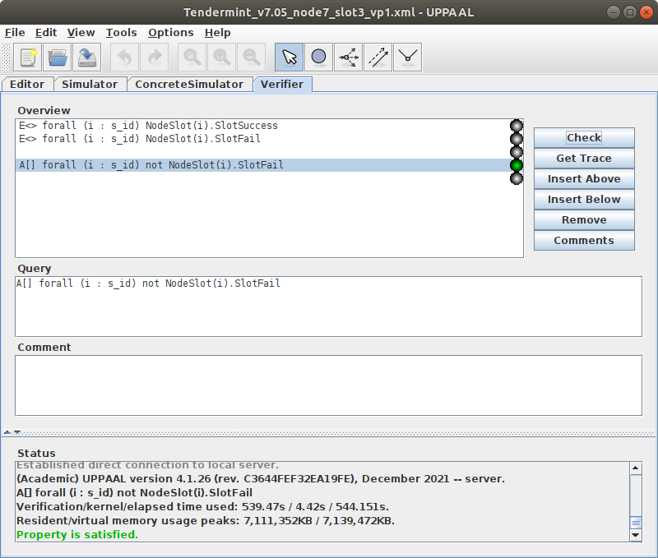
Tendermint_v7.05_node7_slot3_vp1.xml
(Breadth first/Aggressive/CompactDataStructure option)

Slide 13

Tendermint_v7.05_node8_slot3_vp1.xml
(Breadth first/Aggressive/CompactDataStructure option)

